Slide 1
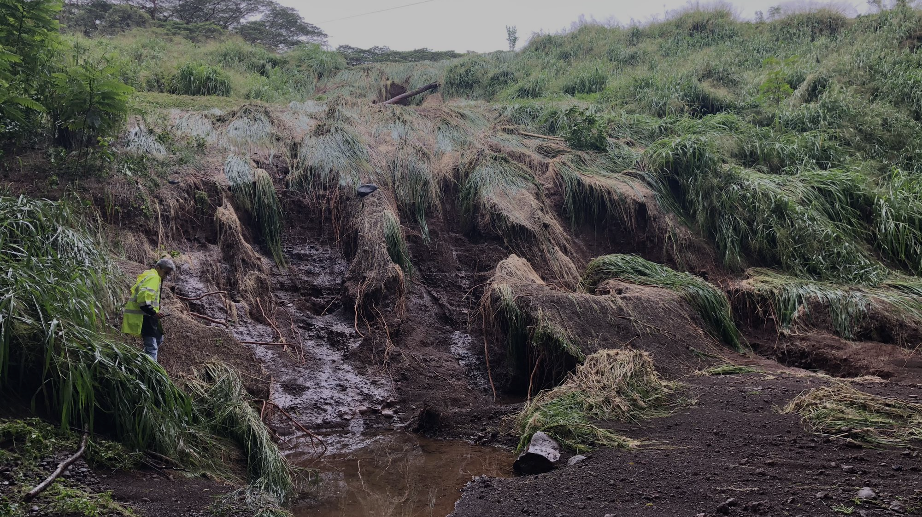
Dam Safety Enforcement Update
Briefing for the Board of Land and Natural Resources
March 25, 2021
DLNR Engineering Division
Flood Control and Dam Safety Section

Slide 2
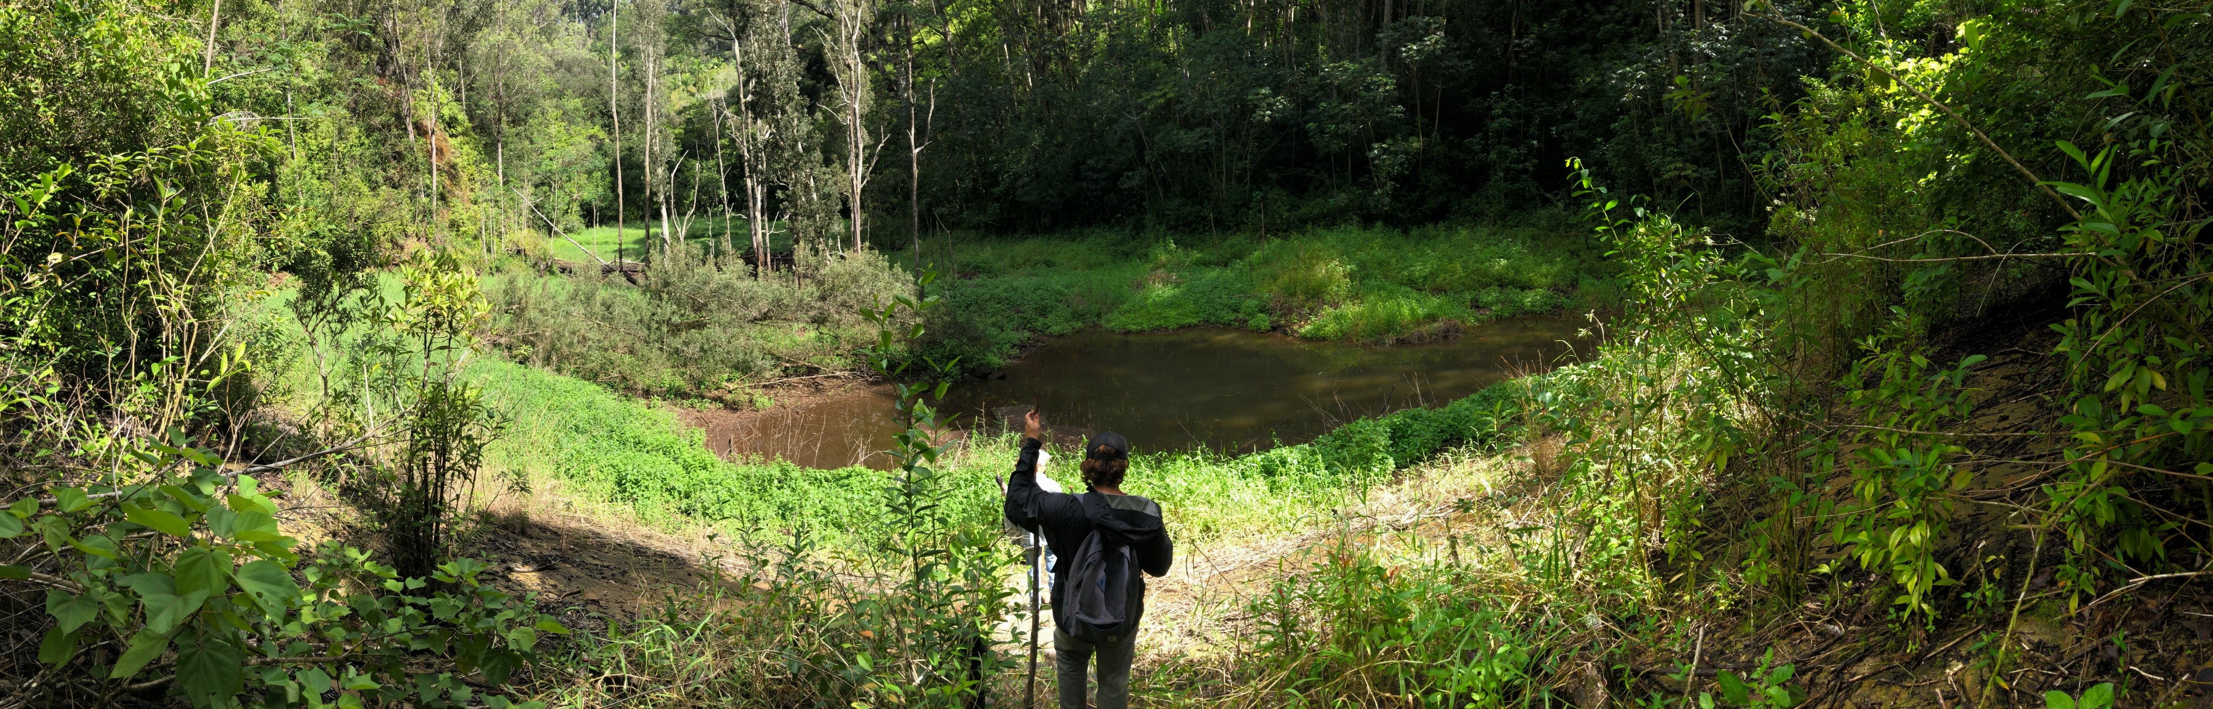
Purpose of Briefing
  Dam Safety Program and Board Authority
  Enforcement Plan
Hawaii Dam and Reservoir Safety Program
…to protect the health, safety, and welfare of the citizens of the State by reducing the risk of failure of dams and reservoirs

Slide 3

Background and
Recap of 2020 Board Briefing

Slide 4
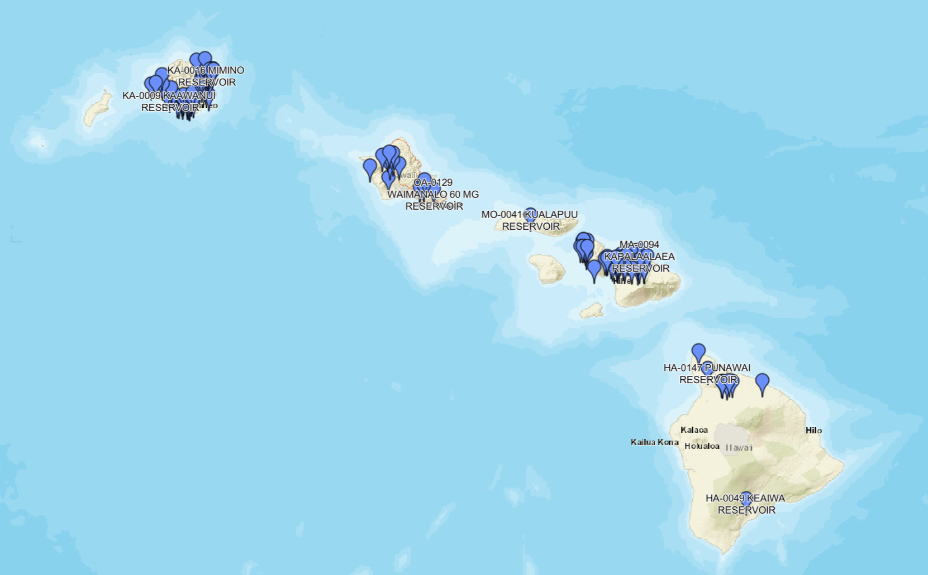

131 Regulated Dams
52 Dams
13 Dams
56 Dams
25 Dams Removed
10 Dams
Notes:
Currently the Department regulates 131 dams and reservoirs throughout the State.
Most of the reservoirs are located on Kauai and Maui.

Slide 5
Hazard Potential Classification
HIGH HAZARD - means a dam or reservoir failure will result in probable loss of human life.
SIGNIFICANT HAZARD - means a dam or reservoir failure will result in no probable loss of human life but can cause major economic loss, environmental damage, disruption of lifeline facilities, or impact other concerns.
LOW HAZARD - means a dam or reservoir failure will result in no probable loss of human life and low economic loss or environmental loss, or both. Economic losses are principally limited to the owner's property.
Notes:
Almost all of the dams in Hawaii are classified as having a High Hazard Potential Classification, in that if they were to fail the resulting flood would probably result in the loss of life.
Haz Potential is based solely on the downstream community development and uses.

Slide 6
Overall Condition Assessment
31% Poor
5% Unsatisfactory
61% Fair
2% Satisfactory
SATISFACTORY - No existing or potential dam safety deficiencies are recognized. Acceptable performance is expected under all loading conditions (static, hydrologic, seismic) in accordance with the applicable regulatory criteria or tolerable risk guidelines.
FAIR - No existing dam safety deficiencies are recognized for normal loading conditions. Rare or extreme hydrologic and/or seismic events may result in a dam safety deficiency. Risk may be in the range to take further action.
POOR - A dam safety deficiency is recognized for loading conditions which may realistically occur. Remedial action is necessary. POOR may also be used when uncertainties exist as to critical analysis parameters which identify a potential dam safety deficiency. Further investigations and studies are necessary.
UNSATISFACTORY - A dam safety deficiency is recognized that requires immediate or emergency remedial action for problem resolution.
Overall Condition Assessment Classifications based on system adopted by the 2018 National Inventory of Dams
Notes:
For Physical or Operational Deficiencies
Normal conditions expected today or tomorrow,
Satisfactory dams ok
Fair dams ok, however not up to statutory requirements
Poor dams have deficiencies which conditions that could occur
For poor dams we have restrictions on water storage.
Unsatisfactory dams have a deficiency that may have pressing condition
Require owners to keep these dams empty

Slide 7
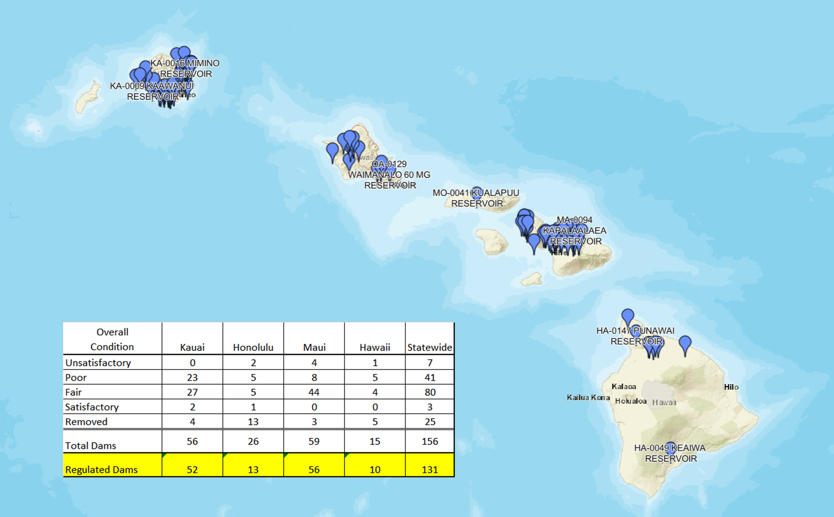
Overall Condition Assessment
Overall Condition Assessment | Kauai County | C&C of Honolulu | Maui County | Hawaii County | Statewide
Satisfactory | 2 | 1 | 0 | 0 | 3
Fair | 27 | 5 | 44 | 4 | 80
Poor | 23 | 5 | 8 | 5 | 41
Unsatisfactory | 0 | 2 | 4 | 1 | 7
Total | 50 | 13 | 56 | 10 | 131
Updated as of 2013

Slide 8
Gov’t Ownership of Regulated Dams
Hazard Potential Classification | Statewide |  |  | Kauai County |  |  | C&C of Honolulu |  |  | Maui County |  |  | Hawaii County
 | Total Dams | State Owned | County Owned | Total Dams | State Owned | County Owned | Total Dams | State Owned | County Owned | Total Dams | State Owned | County Owned | Total Dams | State Owned | County Owned
High | 122 | 13 | 17 | 48 | 8 | 1 | 12 | 1 | 4 | 53 | 1 | 9 | 9 | 3 | 3
Significant | 3 | 0 | 1 | 0 | 0 | 0 | 0 | 0 | 0 | 2 | 0 | 1 | 1 | 0 | 0
Low | 5 | 3 | 1 | 4 | 3 | 0 | 0 | 0 | 0 | 1 | 0 | 1 | 0 | 0 | 0
Total | 131 | 16 | 19 | 52 | 11 | 1 | 13 | 1 | 4 | 56 | 1 | 11 | 10 | 3 | 3
Notes:
Hazard Classifications are based on the Pacific Disaster Center (PDC) Inundation Studies Initiated in 2006
Kauai County has two dams owned by both the State (DLNR) and the Kauai County
(these dams are accounted for in both the State and the County totals)
Honolulu has a dam with an assumed High Hazard Potential Classification dam, which has not been studied
Honolulu has two dams owned by the Federal Government (US Army)
Notes:
The important take away from this chart is that approximately 70% of the dams in the State are privately owned.
Meaning that

Slide 9
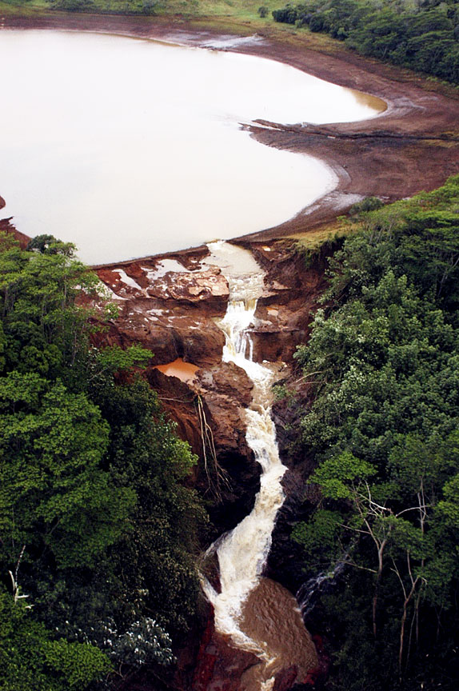
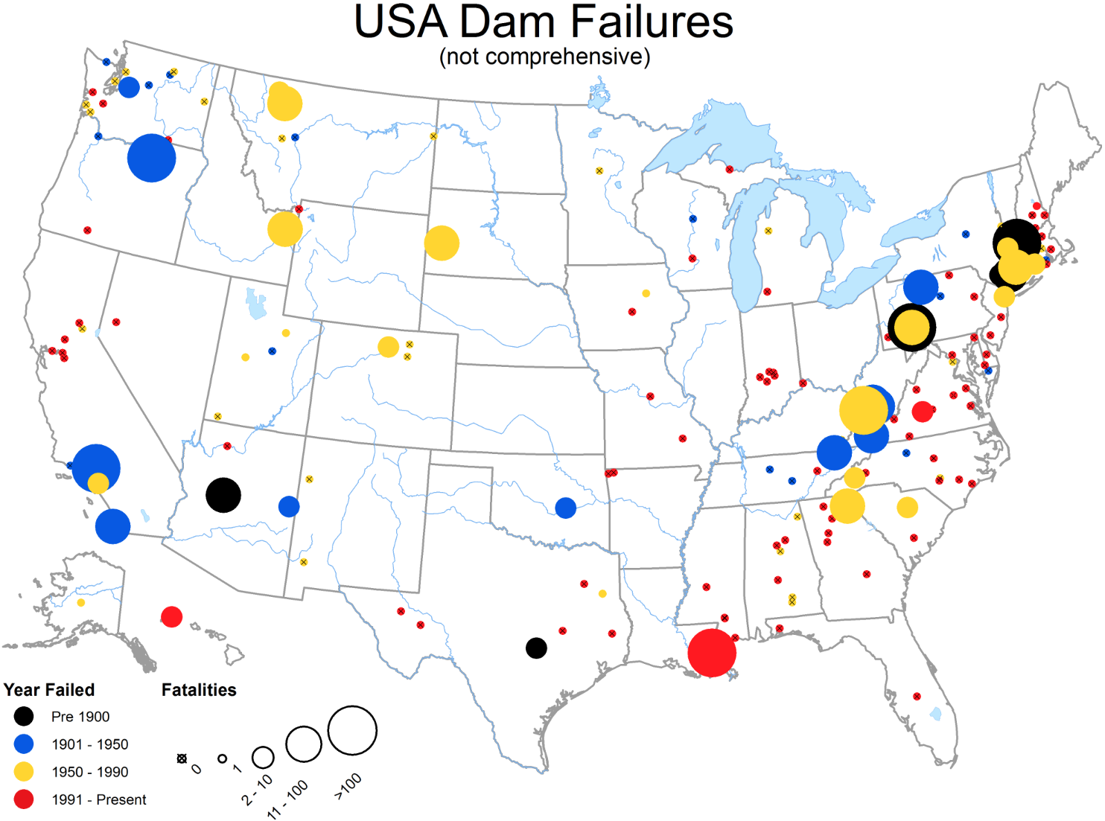
Kaloko Dam Failure
Chart: ASDSO Dam Failures
March 14, 2006
Kaloko Dam Break, Kauai
7 lives lost
Photo credit: Star Bulletin
Notes:
Contributing factors
No inspection
Non-responsive owner
Outdated hazard classification – Identified as low hazard
lack of program funding
Owner lack of understanding
Filled in Spillway
Improper Operation
Owner and Operator at odds
Lack of Maintenance and Monitoring
Lack of Hazard Communication
Downstream community unaware of risks
Older structure not required to be brought up to current standards

Slide 10
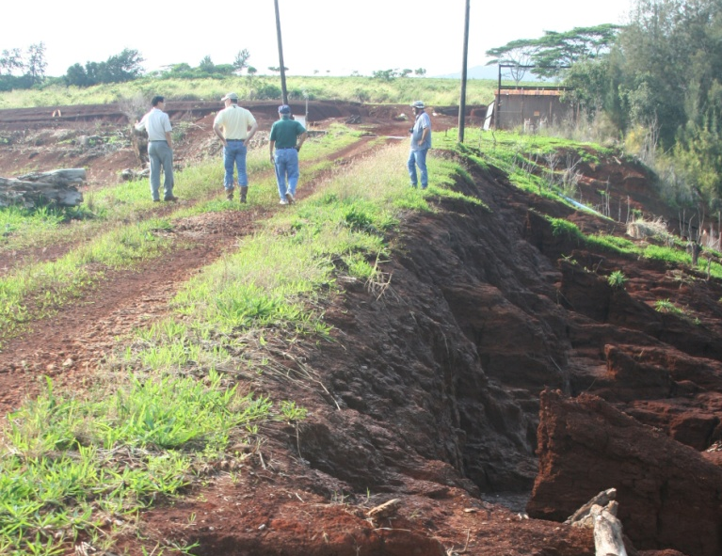
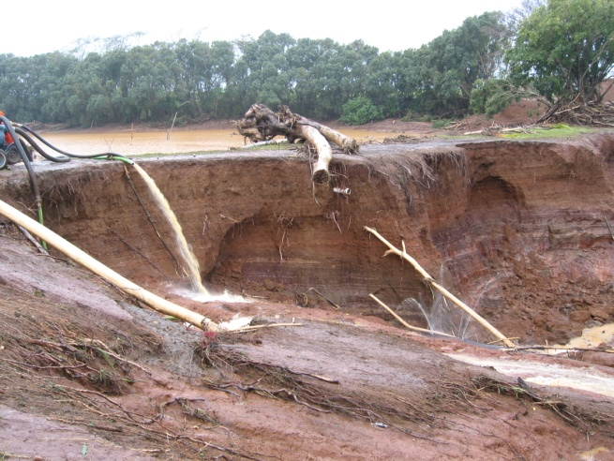
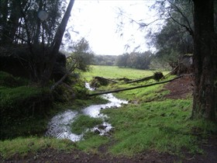
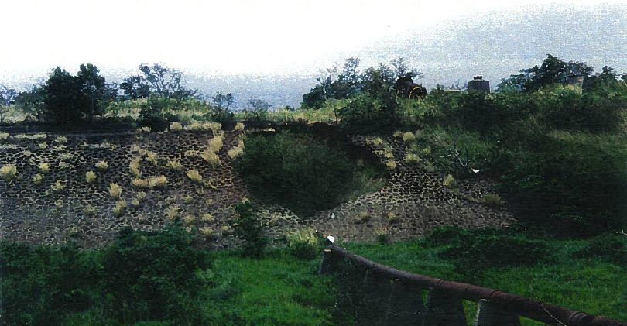
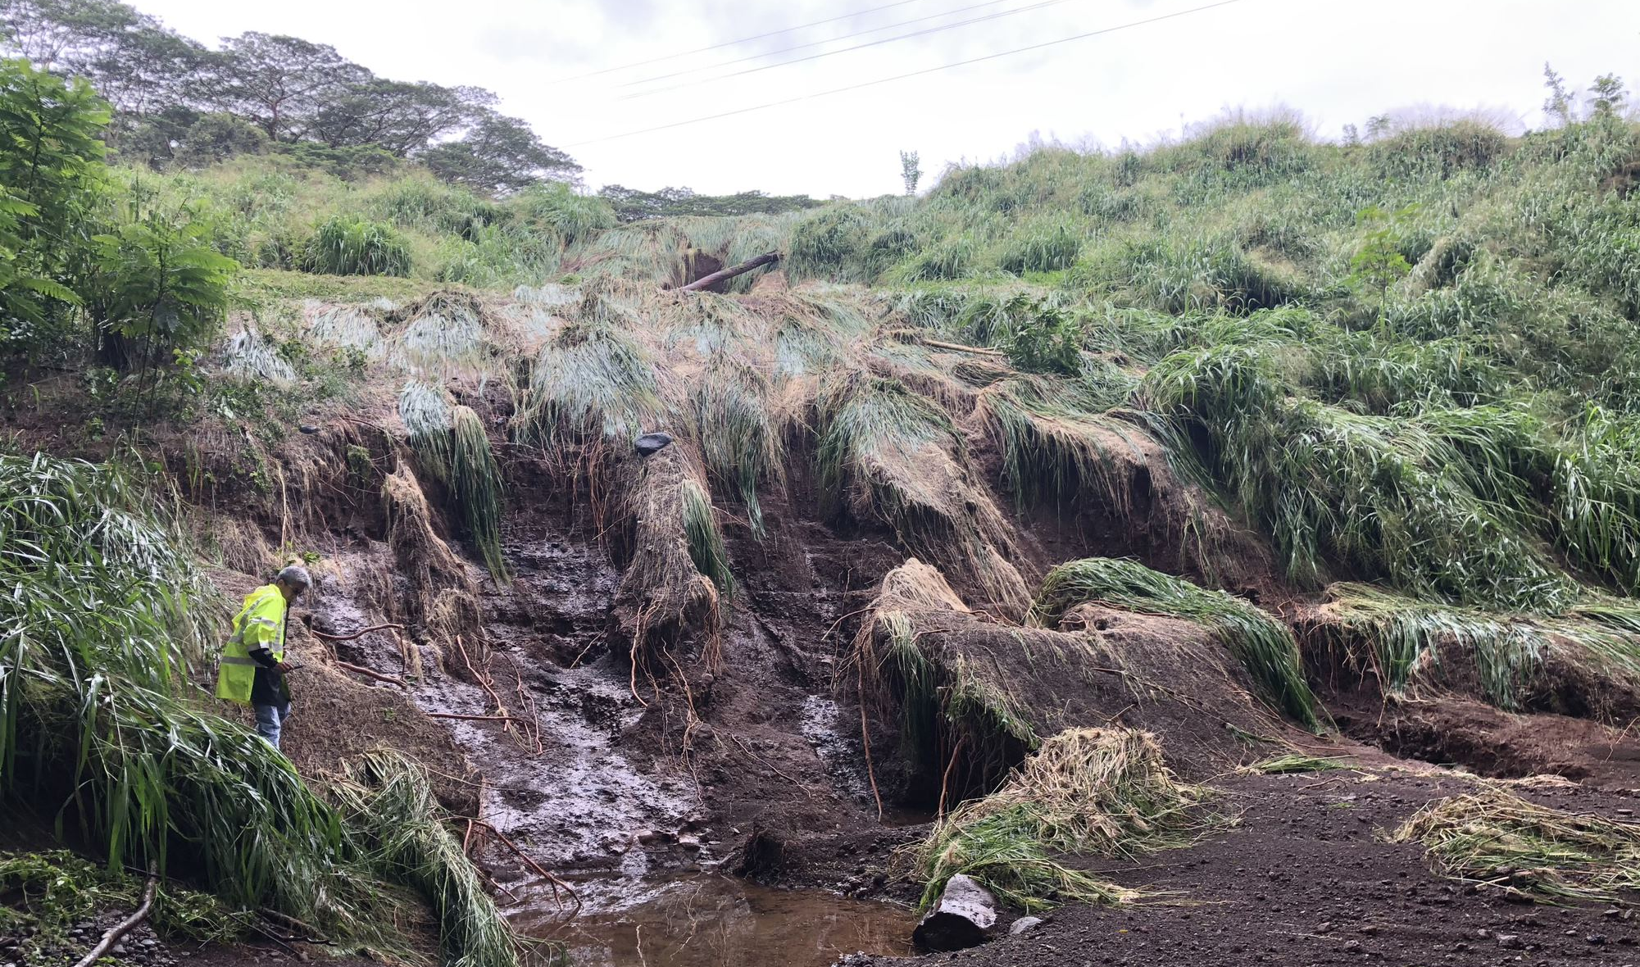
December 11, 2008
Helemano 11 Overtopping,
Oahu
March 14, 2006
Morita Reservoir Overtopping,
Kauai
1994
Horner Reservoir Breach, Maui
Kahena Dam Breach, Hawaii
Incidents
March 8, 2021
Kaupakalua Reservoir Overtopping, Maui

Slide 11
Hawaii Dam and Reservoir Safety Act of 2007
BLNR Authorities (HRS 179D)
Consider dams and reservoirs as important water resources for the State that provide significant benefits to the general public, including irrigation for agriculture and other important uses, and acknowledge the need for dams and reservoirs to be consistently maintained and operated in a safe and feasible manner that sustains their roles as important water resources; provided that public safety concerns are addressed;
Establish Rules
Catalog and Maintain Inventory of Regulated Dams and Reservoirs
Approve, Suspend or Revoke Dam Safety Permits for Construction, Alteration, & Removal
Issue Certificates of Approval to Impound
Issue Orders for Remedial Measures
Enforcement Actions including Civil Penalties and Placing liens on Property

Slide 12

Major Functions of the Dam Safety Program
Inventory & Classifications
Training & Outreach
Inspections
Emergency Preparedness Assistance
Enforcement Actions
Certificate to Impound Water
Permits - New, Alteration,
or Removal
Technical Assistance

Slide 13
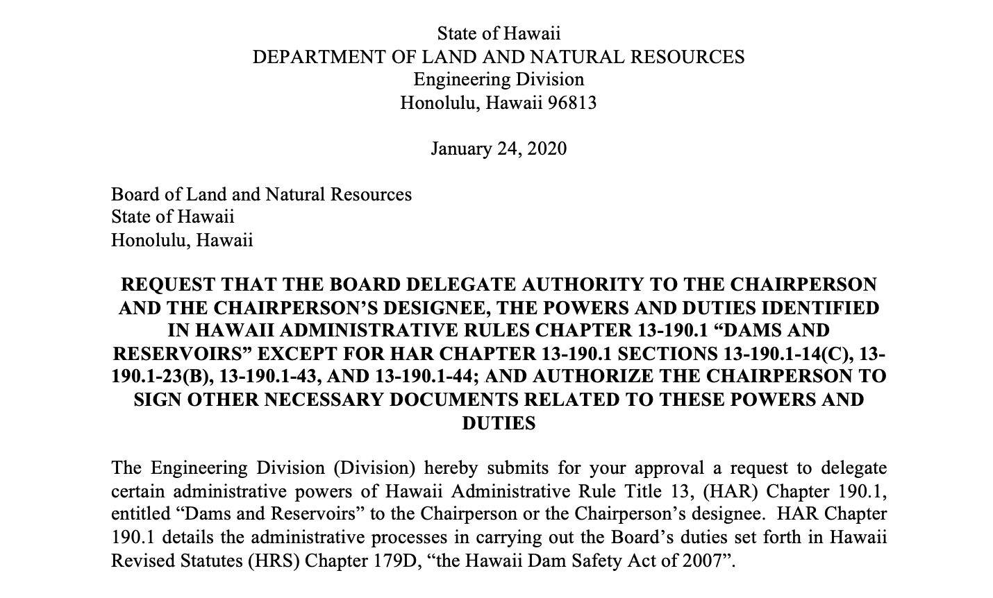
Jan 2020 Board Delegation of Authority

Slide 14
BLNR Dam Safety Roles (in green)
Not Delegated to Staff
Inventory & Classifications
Training & Outreach
Inspections
Enforcement Actions
Emergency Preparedness Assistance
Board may Set / Charge
Administrative Penalty
And Impose Liens
Certificate to Impound Water
Permits - New, Alteration,
or Removal
Board shall Approve Issuance of Certificates
Technical Assistance
Board shall Approve
Dam Safety Permits

Slide 15
Dam Safety Enforcement

Slide 16

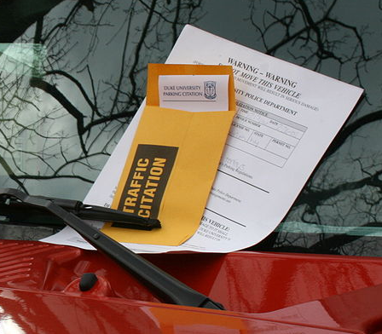

Enforcement Actions
Board Action
Civil Resource Violation
Notice of Deficiency

Slide 17

Notice of Deficiency
What triggers an NOD?
  Dam poses a safety risk, or is at risk of failure
    Dam owner violates a regulation(s)
    Unaddressed dam deficiencies
    Dam in unsatisfactory or poor condition

Slide 18
Notice of Deficiency
Owner/Operator Mitigation Options
Dam Safety Permit Application
Initiate Construction
Department will set Remediation Milestones
Monitoring of deficiencies
Retain consultant
Complete required studies
Submit completed Dam Safety permit application
Start construction
Failure to meet these milestones will result in Enforcement Actions issued administratively or by the Board of Land & Natural Resources

Slide 19
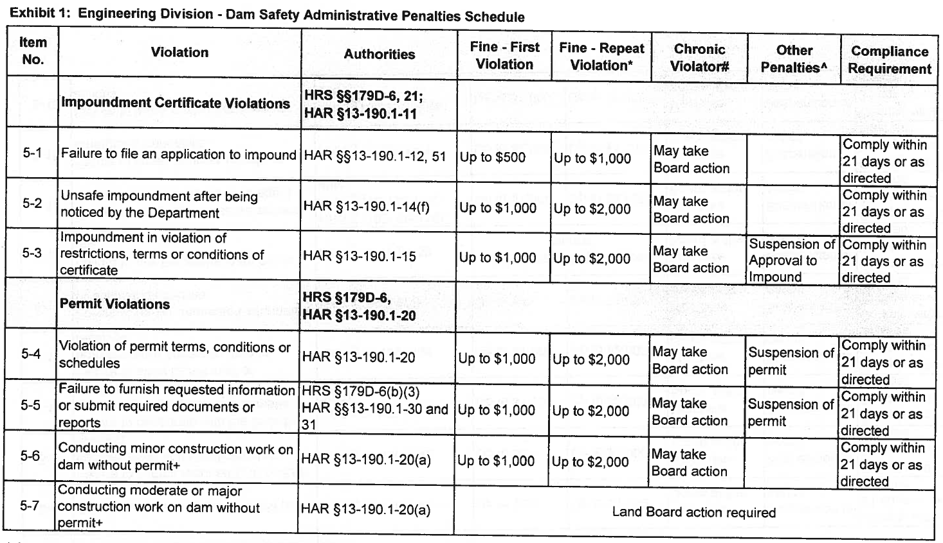
CIVIL RESOURCE VIOLATION
Page 1 of 2
Dam Safety Administrative Penalties Schedule
MINOR
This table used to determine
the fine amounts for first and
repeat violations.
For chronic violators, the table
can be used to discern between
minor and major violations.
(If not marked MINOR, it’s a
MAJOR.)

Slide 20
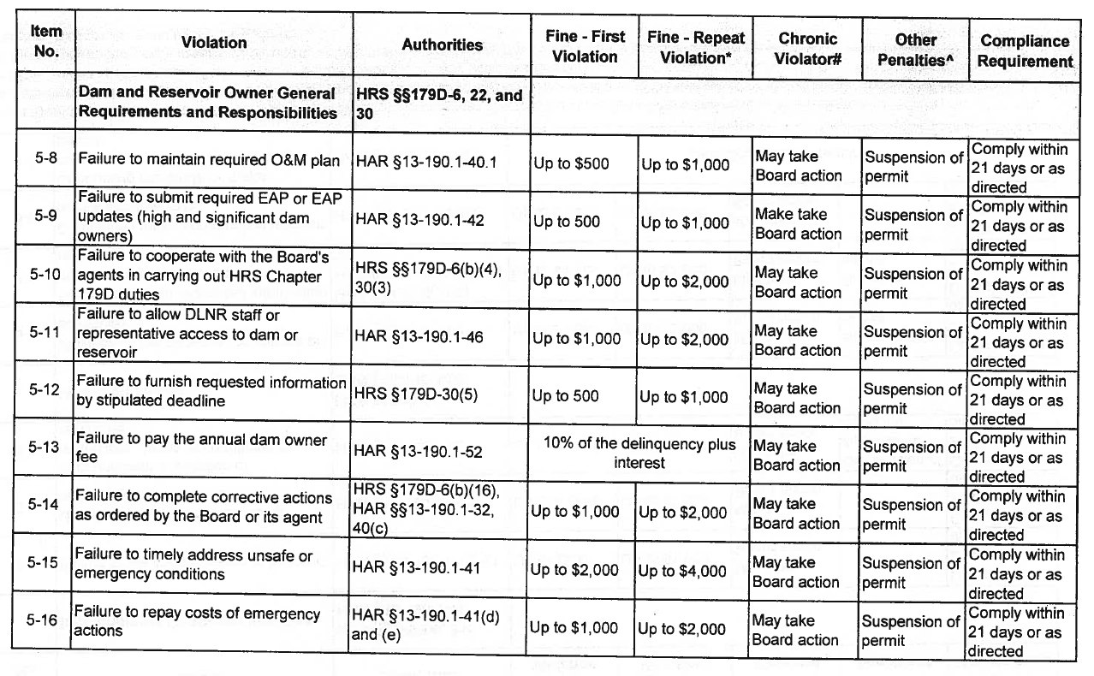
CIVIL RESOURCE VIOLATION
2 of 2
Dam Safety Administrative Penalties Schedule
MINOR
MINOR
This table used to determine
the fine amounts for first and
repeat violations.
For chronic violators, the table
can be used to discern between
minor and major violations.
(If not marked MINOR, it’s a
MAJOR.)
MINOR

Slide 21
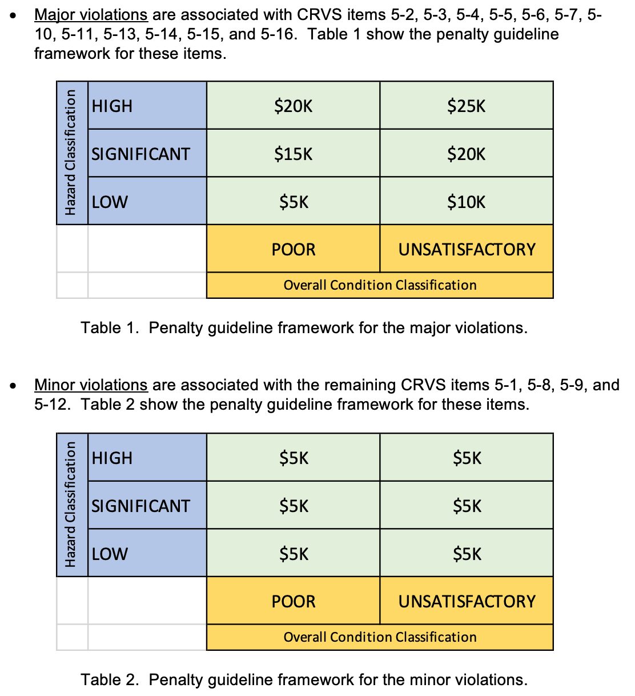
Penalty Calculation
For Board Action
Note: Based on an internal guideline Dam Safety Violation Penalties Framework
Penalty = f (Risk from dam failure)
Major or minor violation
Hazard classification
Overall condition

Slide 22
Recap of
Dam Safety Enforcement Plan
DLNR Enforcement Actions
Notice of Deficiency
Civil Resource Violation
Board Enforcement Action
Board Action
Informs dam owner of violation(s)
Remediation schedule & deadlines
Fines up to $4,000 per incident
Chronic violators
First or second violators (typically)
Fines up to $25,000 per incident per day
Unaddressed items from Notice of Deficiency
Other, additional actions

Slide 23
Thank you
Q & A

