Slide 1


Request for 25-Year Term Extension of General Lease No. S-4946, Sunrise Capital, Inc., Lessee, Hanapepe, Waimea (Kona), Kauai, Tax Map Key: (4) 1-9-010:037.
Board of Land and Natural Resources
January 12, 2024

Slide 2
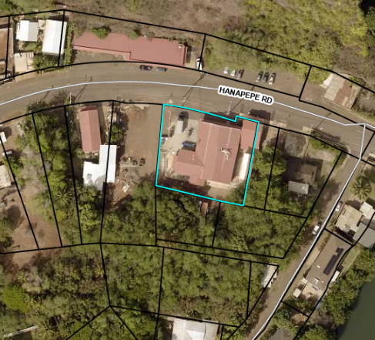
Property Information
Location Address: 3630 Hanapepe Road, Hanapepe, Kauai, Hawaii 96716
TMK No.: (4) 1-9-010-037
Tax Classification: Commercial
Zoning: CG
Land Area (acres): 0.3869
Land Area (approx. sq. ft.): 16,855
Total Property Assessed Value: $1,386,800
Existing Improvements Market Value: $1,100,000

Slide 3
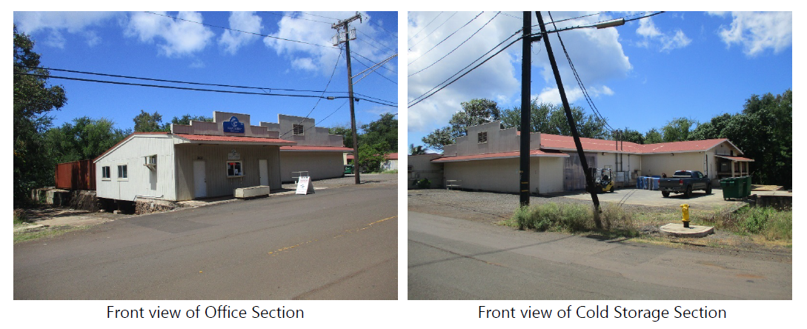
Buildings on Property

Slide 4
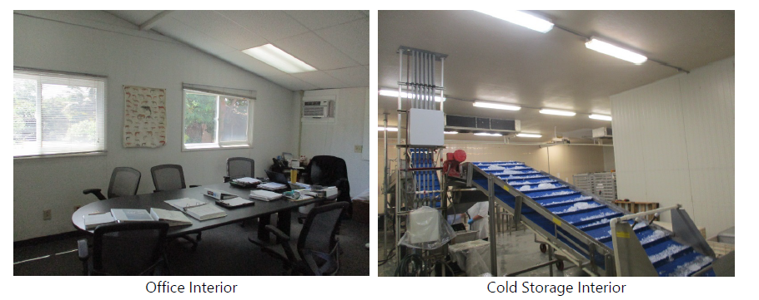
Building Interiors

Slide 5
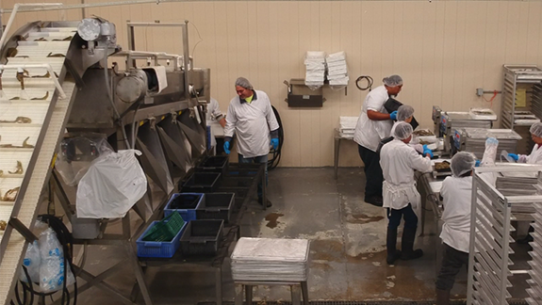
Shrimp Processing in Production

Slide 6
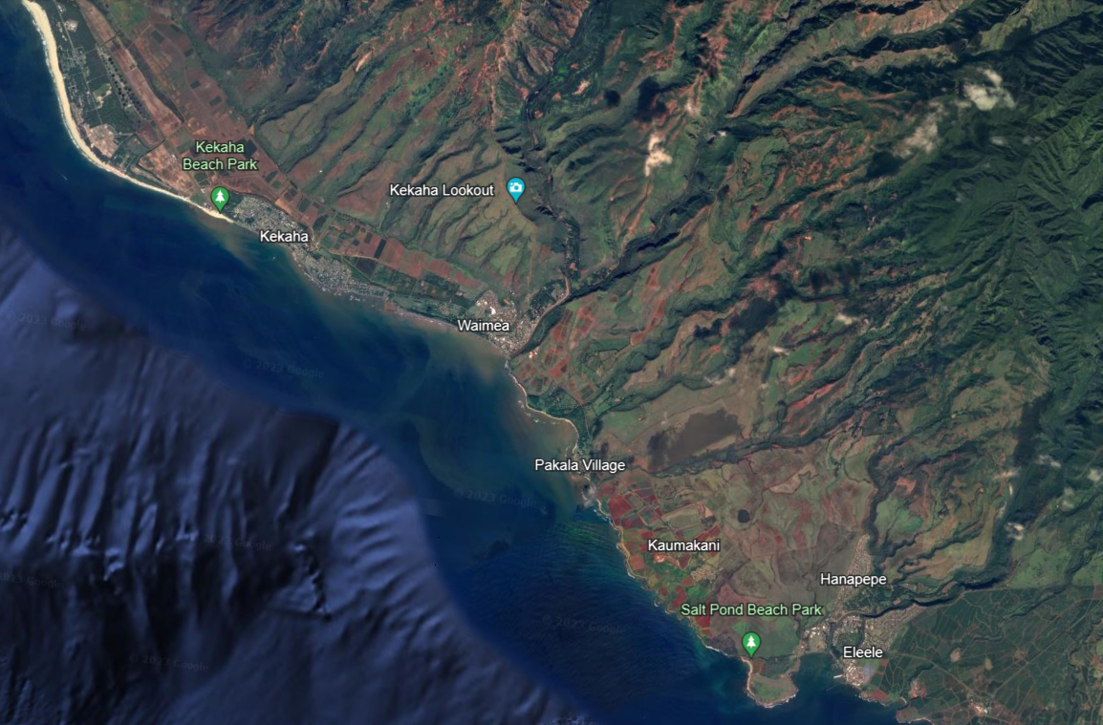
Shrimp Farm
Shrimp Breeding Center
Property’s Relation to Aquaculture Operations and Facilities
Property

Slide 7
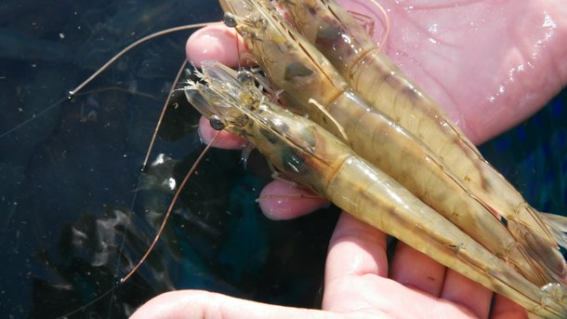
Mahalo

